Slide 1
UNIT THREE
EVOLUTION OF MANAGEMENT THOUGHT

Slide 2
Contents
Introduction
Contribution and Limitation of Classical theory, Human relations and Behavioral science theories, System theory, Decision theory, Management science theory, and Contingency theory.
Emerging management concepts: workforce diversity, outsourcing, knowledge management, learning organization.

Slide 3
Scientific management theory
Scientific management: Productivity emerged as a serious business problem during the first few years of this century. Business was expanding and capital was readily available, but labor was short in supply.
Therefore, managers began to search for different ways to utilize existing labor more efficiently.
In response to this need, experts began to focus their research on ways to improve the performance of individual workers. Their work led to the development of scientific management.
Scientific management is an attitude and philosophy, which discard the traditional method of, hit and miss, rule of thumb, trial and error of managing work and workers. The basic purpose of scientific management was to improve labor productivity.

Slide 4
Cont…
Fredrick Winslow Taylor (1856- 1915): F. W. Taylor was a pioneer in the field of labor efficiency. He introduced numerous innovations in how lobs were designed and how workers were trained to perform them. These innovations resulted in higher quality products and improved employee morale. Taylor also formulated the basic ideas of scientific management. He initially worked in the Midvale Steel Company in 1878. Later he joined the Bethlehem Steel Company in Pennsylvania.
In these two factories, he observed production and pay were poor. Inefficiency and waste were very high. He found that the workers output was only about one- third of what was possible. They were deliberately working at slower pace (soldering). In addition, there were no standardized tools, tasks and work processes. In simple words, there was no effective work standards. This caused inefficiency in the work system. In order to solve this problem he used the techniques such as time and motion studies. He stressed on the need for hiring and training workers. He advocated standardization of tools and enough rest to reduce fatigue. He even developed a system of piece work payment system (differential payment system). He has said that the employees could be motivated by the financial or monetary incentives. His pioneering work “The Principles of Scientific Management”, which was published in 1911, explains these principles of scientific management. The main principles of Taylor’s scientific management approach are:

Slide 5
Cont…
Standardization: Standards of work, equipment and process should be fixed by scientifically studying the nature of work. Previously, workers used the “rule of thumb” method.
Time and task study: Time and task study was done to uplift the standards of workers. He says that there is only one best way to do the work. Previously, there was no standard for time and task study.
Systematic selection and training: The operatives should be selected, taught, trained and developed scientifically.
Pay incentives: Each worker is paid on the basis of his work. He implemented a system of piece work payment system.
Close co-operation between managers and operatives: There was a close co-operation between the managers and operatives that encouraged the accomplishment of work, division of work and incentive management.

Slide 6
Cont…
Contribution
It helps to increase the production by the use of standard procedures and optimum use of resources.
It emphasized on the training and development of worker, which will help to increase the output and reduce the waste.
It seeks to minimize the production cost and increase the profit of the organization.
Limitations
Employees cannot only be motivated by the monetary incentives. He has only used the monetary benefits for employee motivation but totally left the psychological factors.
Employees were forced to increase efficiency by increasing their speed to work. This was beyond their capacity.
This theory has focused on the technical aspects of the work by ignoring the human aspects.

Slide 7
Administrative management theory
Henry Fayol (1841- 1945): Whereas scientific management deals with the jobs of individual employees, administrative management focuses on managing the total organization. Henry Fayol was administrative management’s most articulate spokesperson. A French industrialist, Fayol was unknown to U.S. managers and scholars until his most important work, General and Industrial management, was translated into English in 1930. Drawing on his own managerial experience, he attempted to systematize the practice of management to provide guidance and direction to other managers.
Fayol looked upon the elements of management and its functions. He divided a manager’s job into five functions as planning, organizing, commanding, coordinating and controlling. He even divides the industrial activities into six groups as

Slide 8
Cont…
Techinical activities (production, manufacturing)
Commercial activities (Buying, selling)
Financial activities (collection and use of funds)
Security activities (Protection of property and people)
Accounting activities ( balance sheet, cash flow)
Managerial activities ( planning, organizing, commanding, coordinating and controlling)

Slide 9
Henry Fayol’s 14 Principles
Division of Work: right work to right person
Authority and Responsibility
Discipline
Unity of command
Unity of direction
Subordination of individual interests to the general interest

Slide 10
Continue…
Remuneration: Salary
Centralization: Degree of reserving decision making authority at the top level
Scalar chain (line of authority): Unbroken chain of relation from top to bottom
Order: Material order and social order
Equity: Equal treatment
Stability & tenure of personnel: Retaining productive employees
Initiative: Encouraging employees to do assigned task in better way
Esprit de corps

Slide 11
Contribution of Administrative Theory
Administrative management laid heavy emphasis on universal principles of management.
This theory laid the foundation for the study of management functions of planning, organizing, staffing, directing and controlling.
Isolated and analyzed management as a separate discipline

Slide 12
Limitations of Administrative Theory
This theory has not paid proper attention to human behavioral aspects in an organization.
It has not considered the situational factors.
This principle is based on personal experience and little observation.

Slide 13
Difference between Scientific and Administrative Theory
Bases of Differences | Taylor | Fayol
Human Aspect | Disregards human aspect | Pays due regards to human elements. E.g: Principle of initiative, Espirit De’ Corps
Status | Father of scientific management | Father of modern management
Efficiency and administration | Stressed on efficiency | Stressed on general administration
Approach | Micro approach as it focuses on factory only | Macro approach as it discusses general principles of management
Scope of principles | Restricted to production activities | Applicable in all organizations

Slide 14
Theory of bureaucracy
Although Max Weber lived and worked at the same time as Fayol and Taylor, his contributions were not recognized until some years had passed. Weber was a German sociologist, and his most important work was translated into English until 1947. Weber’s work on bureaucracy laid the foundation for contemporary organization theory. The theory of Social and Economic Organizations explains the basic principles of bureaucracy. Bureaucracy is a system characterized by division of labor, a clearly defined hierarchy, detailed rules and regulations, and impersonal relationships. The important contents of Weber’s theory of bureaucracy are as follows:

Slide 15
Cont…
Job Specialization: Jobs are broken down into simple, routine and well defined tasks.
Authority hierarchy: Officers or positions are organized in a hierarchy, each lower one being controlled and supervised by a higher one
Formal selection: All organizational members are to be selected on the basis of technical qualification demonstrated by training, education or formal examination.
Formal rules and regulations: To ensure uniformity and to regulate actions of employees, managers must depend heavily on formal organizational rules.
Impersonality: Rules and controls are applied uniformly, avoiding involvement with personalities and personal preferences of employees.
Career orientation: Managers are professional official rather than owners of the units they manage. They work for fixed salaries and pursue their careers within the organization.

Slide 16
The Bureaucracy
Strengths
  Minimum duplication of personnel and equipment
  Selection and placement based on technical competence
  System of rules and regulations
Weaknesses
  Obsessive concern with rules and regulations
  Neglects informal relation

Slide 17
Behavioral science theory
Early advocates of the classical management perspective essentially viewed organizations and jobs from a mechanistic point of view: that is, they essentially sought to conceptualize organizations as machines and workers as cogs within those machines. Even though many early writers recognized the role of individuals, their focus tended to be on how managers could control and standardize the behavior of their employees.
In contrast, the behavioral science perspective placed much more emphasis on individual attitudes and behaviors and on group processes and recognized the importance of behavioral processes in the workplace. This theory describes about the human side of the organization and portrays that the workers can never be motivated by the economic incentives only. The findings of these studies can be grouped in two categories as human relations approach and behavioral science approach.

Slide 18
Human Relation Approach
The human relations approach was stimulated by a group of researchers from Harvard University who conducted a series of studies among several groups of workers at the Hawthorne plant of the Western Electric Company in Chicago.

Slide 19
Human Relation Approach..cont’
HAWTHORNE EXPERIMENT
Elton Mayo was the leader of this experimental team
These researchers undertook four experiments at different time periods. They are
Illumination experiment.
The relay assembly test room experiment.
Mass interviewing program.
Bank wiring observation room experiment.

Slide 20
Cont…
1. Illumination experiment: The experiment was held in 1924 at Hawthorne plant and continued for three years. The researchers used this experiment with the light in the working place of the workers. When the illumination of the light was increased the productivity increased and when the illumination of the light decreased, the output of the workers or productivity still increased. The result describes that the productivity is not dependent of the illumination of the light but on the feelings of importance. The research concludes that the factors as hours of work, wage incentives etc. did not really affect over the employee efficiency but change in attitude of employees has significant effects on the productivity.

Slide 21
2. The Relay Assembly Test Room Experiment
The researchers set up a relay assembly test room where two girls were chosen. These girls were asked to choose for more girls as co-workers. The work was related with the assembly of telephone relays where each relay consisted of a number of parts that the girls assembles into finished product. The changes were carried out in the working hour, rest time, lunch time etc.
As each positive change was introduced, absenteeism decreased, morale increased, and less supervision was required. Again, the change was reverted back to the original position and surprisingly, the productivity increased further instead of going down. This concludes that the socio- psychological factors as feeling of importance, recognition, participation and non-directive supervision are the key for high productivity in workers.

Slide 22
3. Mass Interviewing Program
During the course of experiments, about 20,000 interviews were conducted between 1928 and 1930 to determine employees’ attitudes towards company, supervision, insurance plans, promotion and wages.
The results of the interview concluded that the social groups were being formed informally at the workplaces. These informal groups have a high effect over their members and these groups could exercise huge control over the performance of their members.

Slide 23
Bank Wiring Observation Room Experiment
In this experiment, 14 male workers were intensively observed for seven months in the bank wiring room. This experiment concluded that the informal groups are very powerful inside the organization and they have their own values, beliefs and attitudes. They have their own production norms and the members of their group must follow these norms.
This theory also concluded that employee would labor hard if they believe that the management was concerned about their welfare and supervisors paid special attention and care to them. Thus productivity can be improved by social factors such as moral and satisfactory relationships between management and workers.
Finally, the researchers described that concept of “social man theory.” i.e. man is a social being and he is live in a group. This group have a huge impact on its behavior and work attitude.

Slide 24
Contribution of Human Relation Theory
Employees are not motivated solely by money. Better relationships between management and workers can increase productivity.
Informal relation among workers influence the worker’s behavior more than formal relation
The importance of recognizing the concept of “social man” became unavoidable.
Employee would labor hard if they believe that the management was concerned about their welfare and supervisors paid special attention and care to them

Slide 25
Limitations of Human Relation Theory
Too much emphasis on human aspect of productivity development. However, productivity also depends on technological and other factors.
Hawthorne experiments were conducted in controlled situation which cannot be generalized in real life situation
Hawthorne experiments gave too much emphasis on group decision making, however many of the times, organization need to have individual decision making too.

Slide 26
Behavior Science Approach
Behavioral scientists have made notable contribution to the management theory and practice. They are
Abraham Maslow Need Hierarchy Theory.
Douglas McGregor Theory X & Theory Y.
Frederick Herzberg Two Factor Theory.

Slide 27
Hierarchy of Needs Theory (Maslow)
Hierarchy of Needs Theory
There is a hierarchy of five needs—physiological (basic), safety (security), social, esteem (Ego), and self-actualization; as each need is substantially satisfied, the next need becomes dominant.

Slide 28
Cont’
Developed by Abraham Maslow.
Lower-order and higher-order needs affect workplace behavior and attitudes.
Lower-order needs:
  Physiological, safety, and social needs.
  Desires for physical and social well being.
Higher-order needs:
  Esteem and self-actualization needs.
  Desire for psychological growth and development.

Slide 29
Cont’
Hierarchy of needs theory
  Deficit principle
    A satisfied need is not a motivator of behavior.
  Progression principle
    A need at one level does not become activated until the next lower-level need is satisfied.

Slide 30
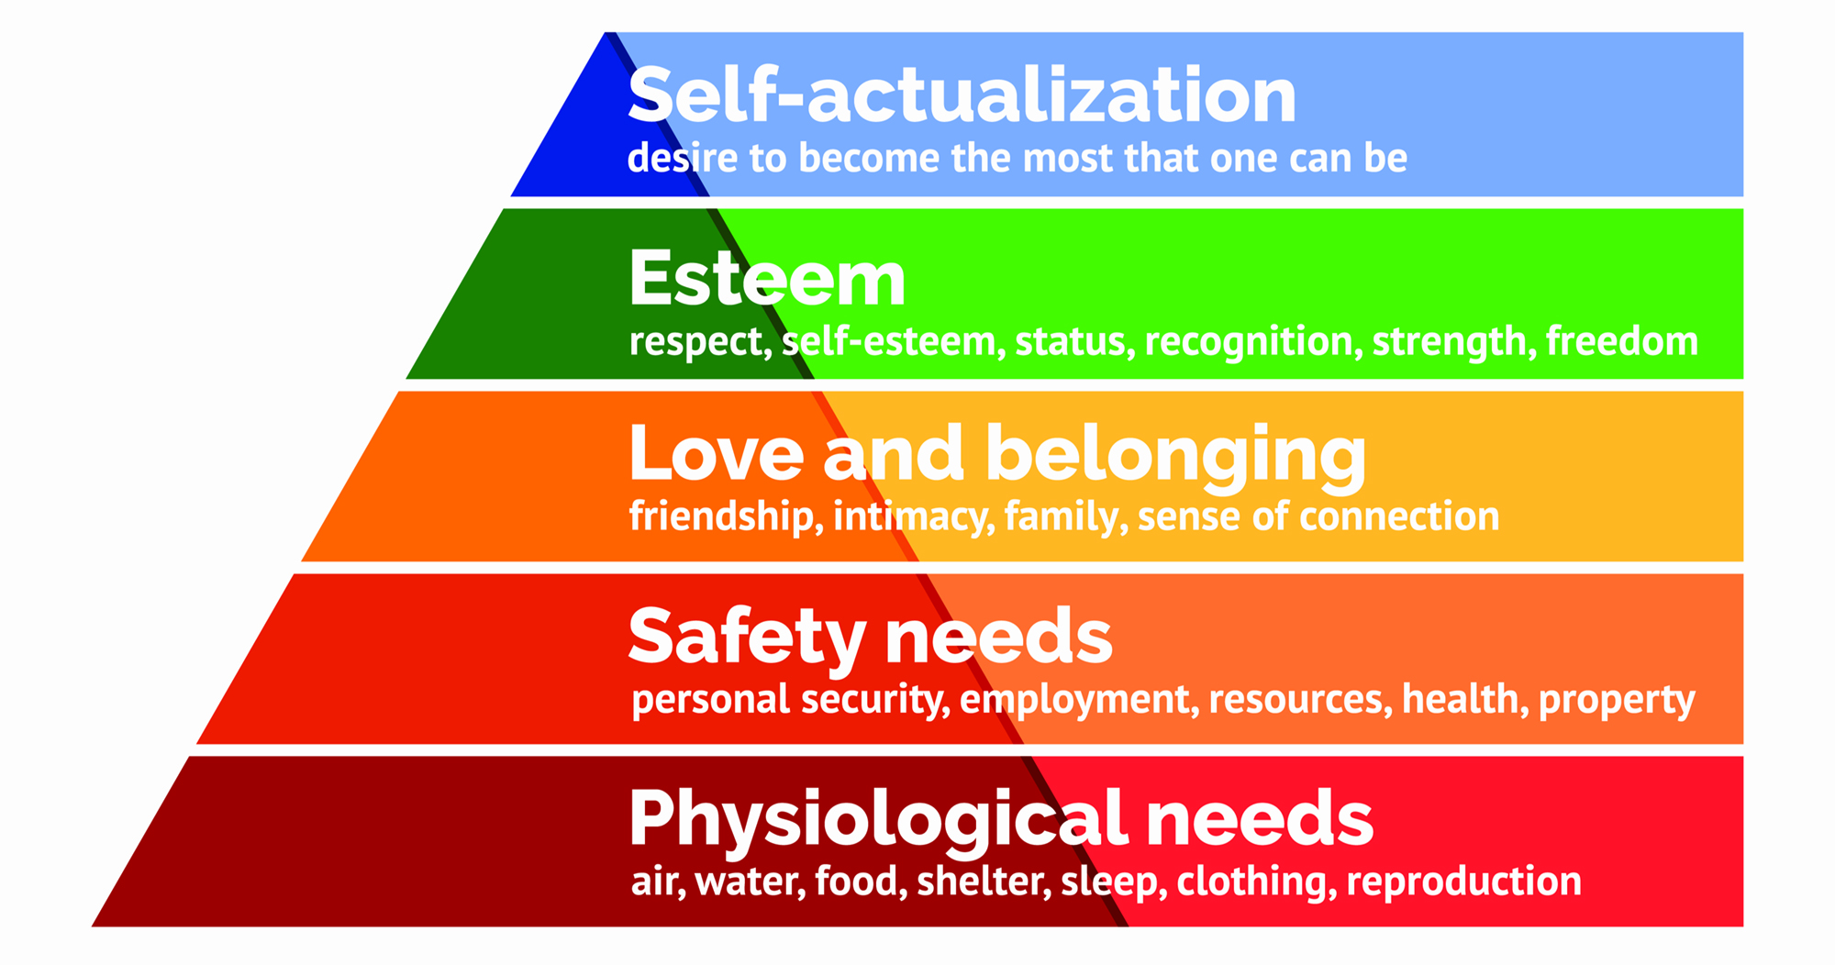
Maslow Hierarchy of Need Diagram

Slide 31
Maslow Hierarchy cont’…
Physiological or basic need: food, shelter and clothing needs
Safety needs: Three categories- economic security, physical security and social security (need for security in old age, fever, and permanent capability)
Social needs: Need for love, care, affection, friendship and belongingness
Esteem/Ego needs: Self esteem needs (internal recognition and self respect) and public esteem needs (image in the eye of the people)

Slide 32
Maslow Hierarchy…cont’
Self actualization needs: Individuals seek challenges and creative work for personal growth and advancement.

Slide 33
Douglas McGregor Theory X and Theory Y
Assumptions of Theory X
Employee dislike work and whenever possible, will attempt to avoid it.
Since employees dislike work, they must be corrected, controlled or threatened with punishment to achieve desired goals.
Most workers place securities above all other factors associated with work and will display little ambition.
Authoritarian leadership style

Slide 34
Cont’
Assumptions of Theory Y
Work is natural activity like, like play or rest.
People are capable of self-direction and self-control if they are committed to objectives.
People will become committed to organizational objectives if they are rewarded for doing so.
Many people in general population have imagination, ingenuity and creativity.
People are creative in solving problems

Slide 35
Herzberg’s Two Factor Theory or Dual Factor Theory or Hygiene Theory of Motivation
Two-factor theory
  Developed by Frederick Herzberg.
  The two factors are extrinsic (hygiene/ maintenance) and intrinsic (motivators/satisfiers)
  Hygiene factors:
    Sources of job dissatisfaction.
    Zero level motivation if maintained properly
    External to job
    Money is the most important hygiene factor

Slide 36
Hertzberg Two Factor Theory Cont’
  Satisfier factors:
    Elements of the job content- the job itself
    Sources of job satisfaction and motivation
  Presence of hygiene factors will lead to no dissatisfaction from employees but absence will lead to dissatisfaction
  Presence of motivators will lead to motivation in employees but absence will lead to low motivation

Slide 37
Contribution of Behavioral Science School/Theory
This theory has identified the role of human elements in organization.
It helps to identify all the needs of staff for the success of management.
It has emphasized on non-financial rewards.
It has also identified the motivational factors of employee.

Slide 38
Limitations of Behavioral Science School/Theory
Neglected the economic dimension of job satisfaction
Lacks scientific validity
It has not considered the situational variables.

Slide 39
Decision theory
Decision theory: The role of management is directly linked with the decision making process. The managers inside an organization have to make different decisions on different situations. Decisions can vary from small works like monitoring the activities, supervising etc. to big works as launching new products, selecting new employees, adjusting organizational structure, setting the goals etc. A lot of decisions are to be made by a manager. So, it is extremely important for the managers to make good and effective decisions.
This theory says that the managers are the main people in the organization and their decisions directly affect over the overall performance of the organization. The success and the failure of the organization directly depends over the managerial decisions. So, it is extremely important for the managers to make good decisions on right time period. Managers in the past used to make decisions on the basis of common sense, intuition or merely an educational guess. The chances of success and failure for such decisions were always 50%. This strategy was not good and the modern managers don’t follow this strategy. They follow mathematical tools to make plans and to provide decisions as probability sampling, linear programming, queuing or waiting line, game theory etc. They even follow a decision making process to give accurate and right decisions.

Slide 40
Cont…
Contributions and limitations
The decision theory has expanded quite considerably over the years. Decision science has now made tremendous development. Many techniques related to decision making like game theory, simulation, decision trees, matrices, etc. developed in course of its development. Today, new technologies called decision support system (DSS), information science, and computer programs are developed to help managers make better decision.
It is now believed that since management is characterized by decision making, the future development of management theory will use the decision making approaches and techniques as its central focus. Management theory is incomplete without consideration of these tools and techniques of decision making.
There are, of course, some limitations of decision theory. It is mostly limited to economic rationale. The considerations of this theory are still very limited and narrow. The decision theory focuses only on some components of decision making. This does not examine and explain the total organizational phenomena.

Slide 41
Management Science Theory
Management science theory emphasizes on application of mathematics and statistics for taking decisions and for solving management problems.
Linear Programming, game theory, sampling theory, probability theory, simulation etc. are the techniques that managers apply to solve resource allocation problems.
Computer programs are used to analyze the problems.
There are three main branches of management science as follows:
1. The quantitative management: This perspective focuses on decision making, economic effectiveness, mathematical models, and the use of computers. Set theory, absolute theory, intervals, probability, etc. are used in this perspective
2. Operations management theory: This theory is concerned with helping the organization more efficiently produce its products or services. This theory describes the way of managing the process of transforming materials, labor and capital into useful products or service. The operations management pays close attention to the demands of quality, customer service, and competition.

Slide 42
Cont…
3. Management Information system(MIS): A management information system organizes past, present and projected data from both internal and external sources and processes it into useable information. This information is made available to the managers at all the organizational levels. The managers can understand about the strengths and weaknesses of the organization and propose different plans to grab the opportunities and be safe from the possible threats.
Generally it is used by middle level and top level managers.

Slide 43
Contributions of Management Science Theory
It has provided managers with plenty of decision – making tools and techniques.
It has contributed in the areas of production and operations management.

Slide 44
Limitations of Management Science Theory
It ignores the importance of people, relationship etc.
It emphasizes on only the aspect of the organization that can be computed in numbers.

Slide 45
System Approach/Theory
A system is defined as “a group of interrelated parts acting together to accomplish a goal”.
Every organization is a system
All systems are composed of three basic elements – inputs into the system, process and output
An organization involves input-conversion-output process.

Slide 46
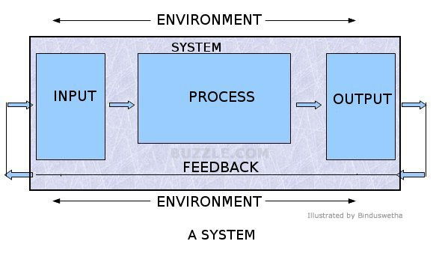
System Approach/Theory

Slide 47
Components of System Approach/Theory
Input: Organization obtains input from environment. Example: Human, financial, physical and informational resources
Process or conversion: Organization transforms input into output. Example: Planning and decision making, organizing, leading, controlling etc.
Output: Organization releases output to its environment. Example: Goods and services
Environment: Internal and external
Feedback: Such information which is assessed by organization after doing some activity on the basis of which organization can improve its operation

Slide 48
SYSTEM APPROACH/THEORY
Elements of a system theory are as follows:
Goal-orientation: Every system has a certain goal that it wants to achieve.
Sub-systems: Each system may have different subsystems that work together. For example, In digestive system, the pancreas or the intestine may have their own subsystem
Open and Closed system: If any system is directly affected by the external environment then it is called open system but if the change in external environment does not affect any system then it is called closed system.
Synergy: Total outcome of system is greater than the sum of the outcomes by the individual parts. i.e. 2+2 = 5
Flow: there is always a flow of input, processing and output in system
Feedback: Every system has an element of feedback. The positive feedback will cause a system to operate in a regular way while a negative feedback will force a system to change for good.

Slide 49
Cont…(Extra)
For example, in order to function, an organization obtains inputs like human resource, financial resource, raw materials, information etc. from the environment. It obtains qualified skilled and motivated employees from universities, competitors and from other organizations. It obtains funds from banks, other lending institutions and from the people who buy shares. Likewise, it obtains raw materials from suppliers and information from journals, reports, periodicals and other external contacts.
These inputs are then coordinated, used and then managed in a conversion/transformation process that produces output. However, the organization’s task is not complete. The customer’s decision to buy or look elsewhere provides feedback to the organization.
If the feedback is positive (the customers buy products), the environment provides it a critical input-cash which the company uses to obtain other inputs such as top quality employees, machines, materials etc. If the feedback is negative (no sales), the environment provide it with a serious problem. And it has to go for corrective actions (for example, Changing product’s design, price, strategies etc.).

Slide 50
Contributions of System Theory
Provides a conceptual framework for a meaningful analysis of management and organization.
Highlights the importance of environment.
Conceptualizes the interactions of various parts of organization
Provides good basis for planning, executing and controlling

Slide 51
Limitations of System Theory
Theory is criticized for being just an abstract thinking.
Does not provide specific guidance on the functions and duties of managers.

Slide 52
Contingency / Situational/ Practical Approach of Management
Paul Lawrence and Jay Lorsch (USA) and Tom Burns and G.M. Stalker (UK) popularized this theory though it was emerged from the experiences of many other managers and practitioners in the field.
According to this theory, the best way to lead, plan, organize and conduct managerial activities varies with the situation
The concepts, tools, and techniques which are highly effective in one situation, are not at all effective in another situation.
The crucial message of contingency theory is that there is no one best way to manage.

Slide 53
Contingency / Situational/ Practical Approach
Some major contingency (situation) variables are:
Size of the organization.
Routine (having specific procedure) and non-routine job
Environmental uncertainty.
Individual differences.
(Note: Describe it as I told you in class and draw figure by yourself as told in class)

Slide 54
Contributions of Contingency Theory
It integrates different schools of thoughts (theories and approaches) and applies them as per the needs of the situation
It depends on multivariate analysis.
The organization structure is modified on the basis of the situation

Slide 55
CONTINGENCY APPROACH
Limitations of Contingency Theory
It’s impossible for managers to determine all the factors relevant to the decision making
It may be costly and time taking to analyze the situation
It didn’t focus which tools should be used in what situation.
It is argued that contingency approach was already asserted by Fayol. He also advocated flexibility in management.

Slide 56
Emerging management concepts
workforce diversity
outsourcing
knowledge management
learning organization.
Assignment: 1. Describe about he emerging management concepts with proper examples
2. Describe about the contingency theory with a clear diagram.

